Slide 1


Slide 2

1ra FN

Slide 3



Slide 4

2da FN

Slide 5
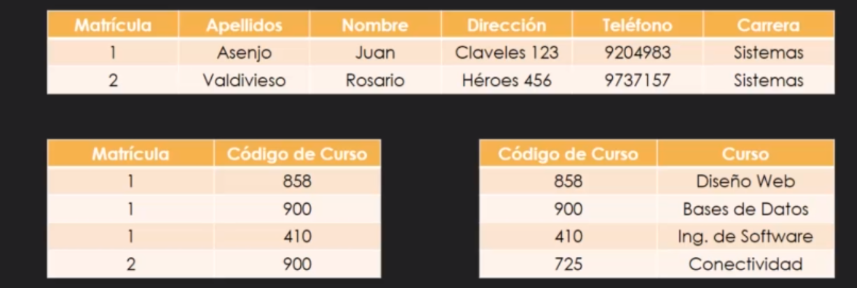

Slide 6

3ra FN

Slide 7
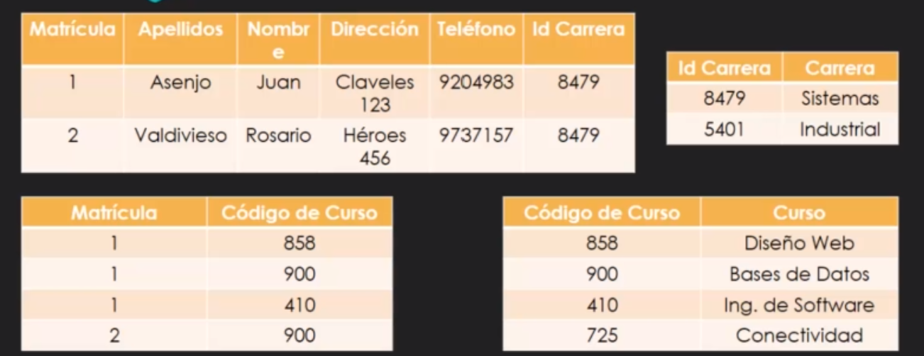

Slide 8


